Slide 1
Service Fabric Patterns & Best Practices

Slide 2
Service Fabric - Migration
Khaled Henidak (Kal)
@khnidk
github.com/khenidak

Slide 3
Problem
How do I migrate existing applications to Service Fabric?
Migration from Azure Classic Cloud Services
Migration from dedicated servers
  On premises
  On cloud
  Bare-metal

Slide 4
Why should you consider migration?
As a first step of “breaking monolith into microservices” journy.
Lift and shift migration (+ slightly change) from on-premises to cloud.
Lower cost by employing high density deployment.
A balanced choice between PaaS and IaaS.
Note: Service Fabric runs everywhere, supporting
  Azure.
  On Prem.
  On other public clouds.

Slide 5
Migration From Cloud Services

Slide 6
Cloud Services to Service Fabric Migration Paths
From | To Guest Executable | To SDK Application
Worker Roles | Wrap your “code” in executable and re-deploy as Guest Executable to Service Fabric | Re-write taking advantages of Service Fabric SDK.
Web Roles | Wrap your “code” in executable and re-deploy as guest executables. Keep in mind that there is no “IIS” on top of service fabric. Use in-proc web servers/listeners (note: ASP.NET < 4.6.2 will not work, MVC Web API will). | Re-write taking advantages of Service Fabric SDK.
Notes on Both | Use SetupEntryPoint to mechanically prepare nodes for apps. Use Service Fabric versioned “Configuration” and “Data” packages to consistently manage them. Each application is a “complete” package that includes everything the app needs to run. No Azure Environment Emulation/Vars/SDK. No role lifetime management for guest executables (i.e. no OnRun/OnRunAsync). Plan for multiple apps instances on same server. | + Follow https://azure.microsoft.com/en-us/documentation/articles/service-fabric-cloud-services-migration-worker-role-stateless-service/ for details on migration.

Slide 7
Preparing Service Fabric nodes for your App
 | Use App Packages Package all application + runtime on a single deployable package (use SetupEntry point for any pre work). | Use Scripts in Setup EntryPoint Use PowerShell scripts to download and install runtime | Use Azure VM Agent Bootstrap upon provisioning
Pros | Service Fabric tooling. Runtime has no footprint on nodes. | Service Fabric tooling. Smaller Packages. Can be used to be upgrade runtime. | Familiar tooling. Good for node wide configuration.
Cons | Large application package takes longer to deploy. Possible complexity with multiple versions of the runtime running together. | Complex scripts to write (consider idempotent + concurrent deployment). | Consider future config changes or upgrades (may require reimaging the node).
Best with | Small runtimes (i.e. python or similar) | Large runtime deployment + low frequency upgrades. | OS/machine wide configuration.

Slide 8
Migration From VMs/IaaS/Bare-Metal
Simple Web App (Web FE Only)
Web FE & Compute
Web FE, Compute & Backend Service

Slide 9
Simple Web Application

Slide 10
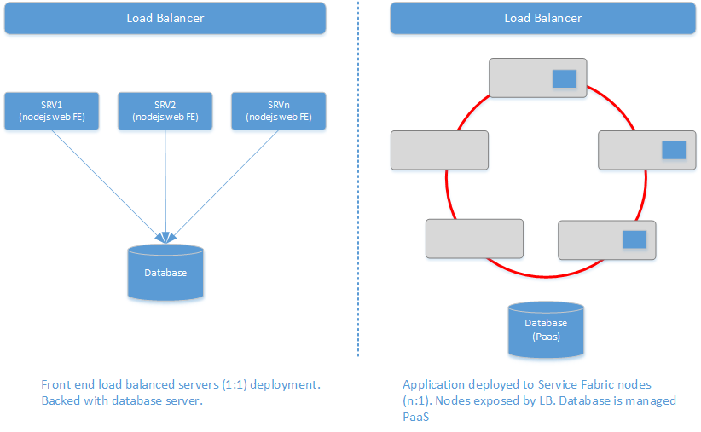
Simple Web Application

Slide 11
Demo: Simple Web Application Migration

Slide 12
Simple Web App – What to watch for?
Servers are commodity they will come and they will absolutely go, frequently.
Treat your app package that gets to deployed to ”green field” servers every time. Use setup entry points to pave servers as needed.
Watch out for instance count, fault domains and upgrade domains.
Full blown / out of proc web servers (IIS/Apache)
    Now: Break the dependencies and move to in-proc listeners.
    Later: Move to “containers” (does not apply on all).
Databases
    Move to managed databases or IaaS (when you absolutely have to).

Slide 13
Web Front End + Compute Service

Slide 14
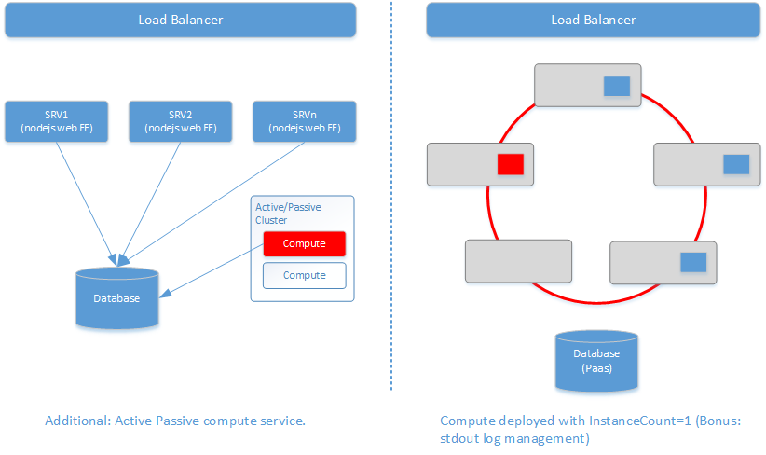
Web Front End + Compute

Slide 15
Demo: Web Front End + Compute + custom stdout

Slide 16
Web FE + Compute – What to watch for?
On Compute
  What is the nature of our Compute Service?
  Can we partition and scale our compute?
Existing Logging
  Avoid major *opps* by reviewing log file naming + location for collision & conflicts.
  Traditional windows specific logging event logs/ETW + custom log files => Azure Diagnostics Extension.
  Custom stdout => use redirect or custom solution.

Slide 17
Web Front End + Backend Service + Compute Service

Slide 18
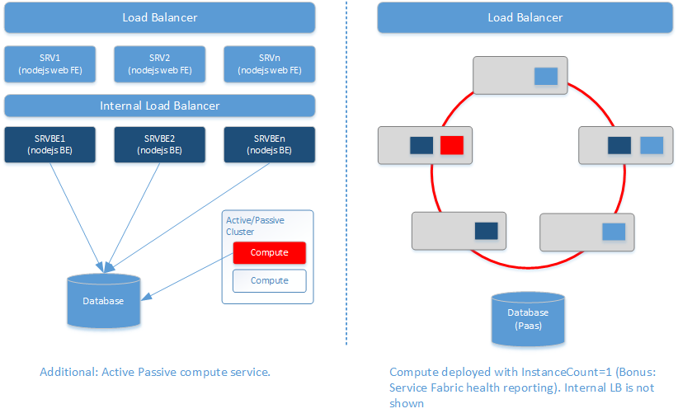
Web FE + Backend FE + Compute

Slide 19
Demo: Web FE + BE + Compute + custom stdout + Health Monitoring

Slide 20
FE + BE + Compute – What to watch for?
On Backend Services
  Customize your cluster by using Azure internal load balancers and/or DMZs.
  Backend Services can be single or multiple instances as needed.
  Keep in mind that Service Fabric runs on customizable VMSSs.
Interacting with Service Fabric
  Guest Executables does not have to live in void.
  App => Service Fabric
    Service Fabric APIs are exposed as REST.
    Use health monitoring as you can.
    Use performance metrics.
  Service Fabric => App
    Metadata information are available to applications as Environment Variables, look for vars prefixed with “Fabric”.

Slide 21
Q / A + More Resources
Service Fabric Application Model https://azure.microsoft.com/en-us/documentation/articles/service-fabric-application-model/
Cloud Service => Service Fabric guide https://azure.microsoft.com/en-us/documentation/articles/service-fabric-cloud-services-migration-worker-role-stateless-service/
Deploying Guest Executable on Service Fabric https://azure.microsoft.com/en-us/documentation/articles/service-fabric-deploy-existing-app/
Creating Azure Internal Load Balancer https://azure.microsoft.com/en-us/documentation/articles/load-balancer-get-started-ilb-arm-cli/
All code used will be on github.com/khenidak

